Slide 1

Hack Club Stardance Challenge
June 1 – October 31, 2026 · in partnership with AMD
Impact Report
For AMD. Confidential.
Contact: Deven Jadhav <deven@hackclub.com>, Chief of Staff, Programs · Zach Latta <zach@hackclub.com>, Executive Director
Notes:
Recap of the Stardance Challenge for Saša Marinkovic (Sr. Director, Global Consumer and AI Experiences Marketing, AMD) and Renee Harkness, Hack Club x AMD updates call, October 26, 2026. Numbers are from the Hack Club data warehouse as of October 26, 2026, five days before the challenge closes. AMD's wrap-up team (Hannah Spooner, Jerry Casey) needs participation numbers, impact and project highlights for a Newsroom story on November 2-3; this deck is the source.

Slide 2
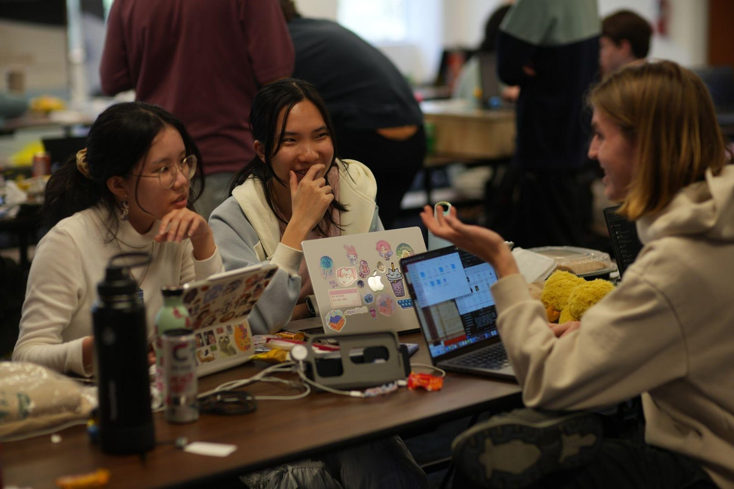
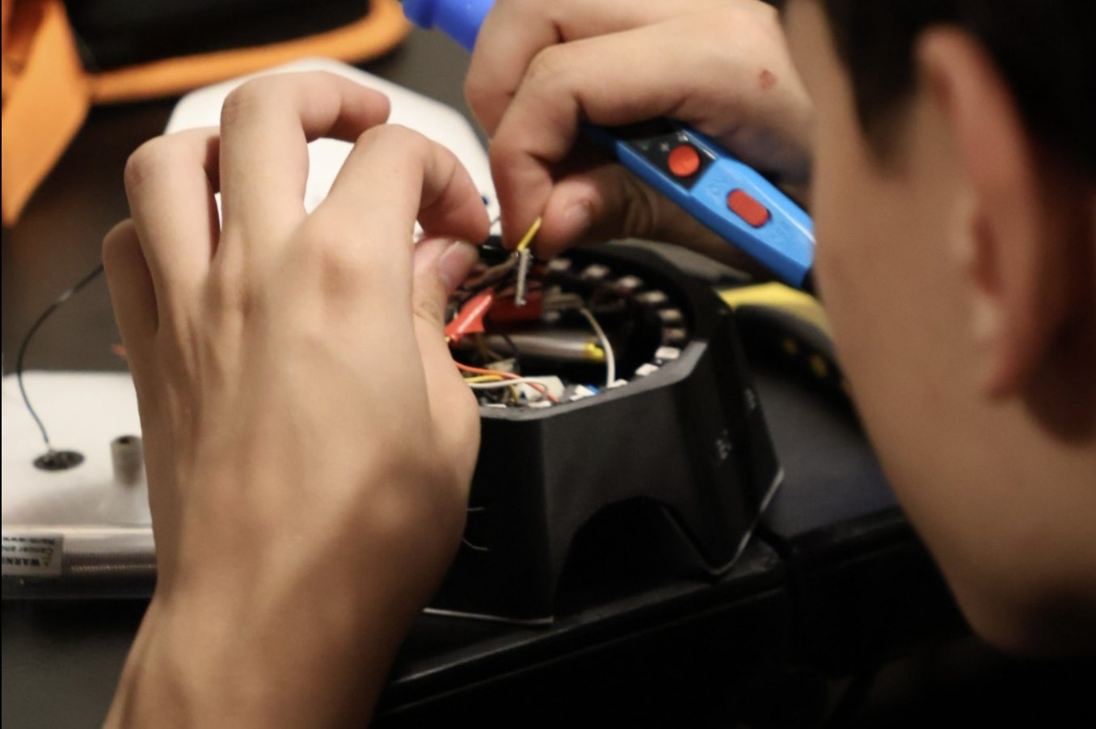
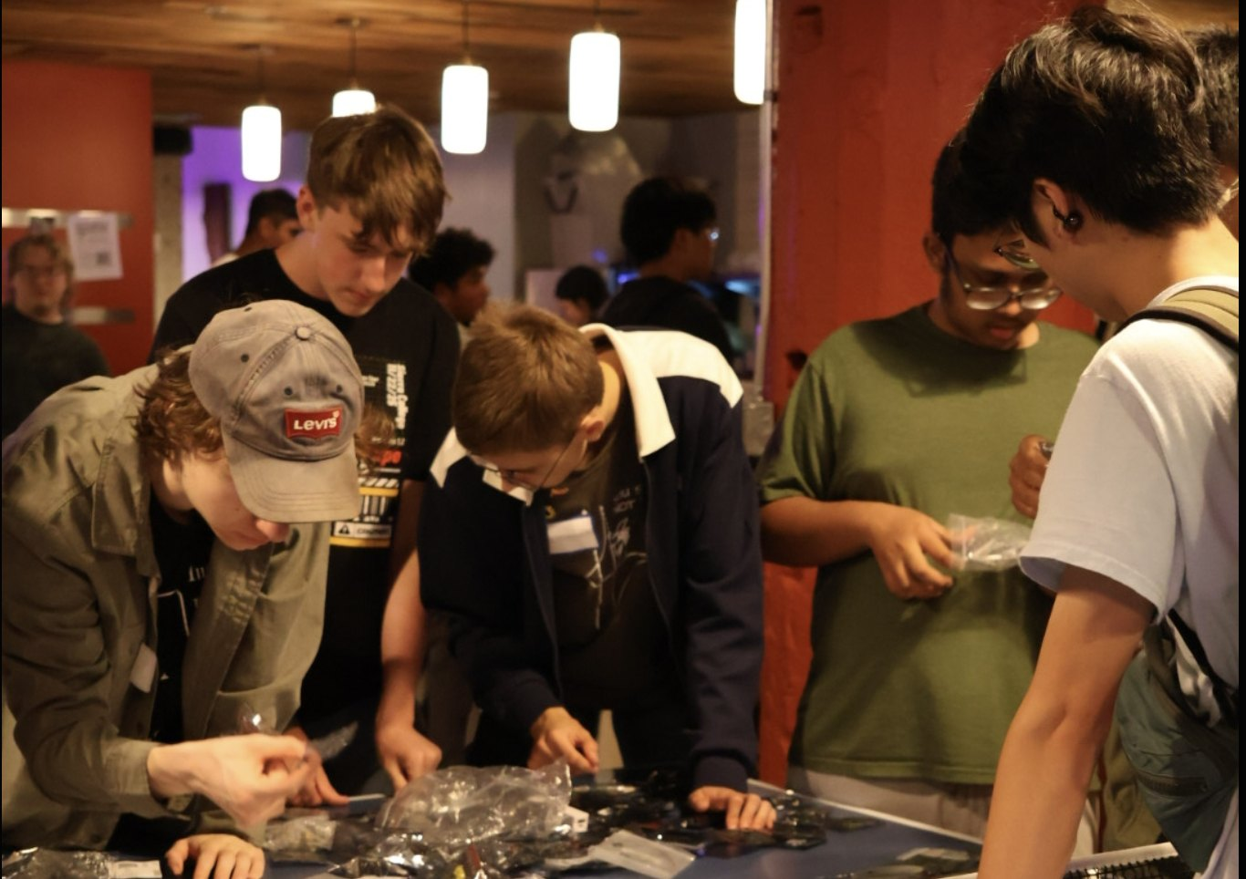
The Stardance Challenge was the biggest high school engineering challenge in American history
69,428 teenagers (ages 13–18) signed up, 21,274 of them American, from all 50 states and DC; the rest came from 180+ countries and territories around the world.
60,684 projects created, and 6,611 projects shipped publicly, each with a working demo and an open-source repo.
164,268 hours of tracked engineering time on projects (that’s 18.8 years of nonstop making).
58,578 public build logs and 61,428 peer reviews. Teenagers reviewed other teenagers’ work and gave feedback on every project.
Notes:
Sign-ups: stardance.materialized_all_signups (69,428; 21,274 US; 51 US regions; 184 country codes). Projects/hours: non-deleted projects in the Stardance app. Shipped = non-draft ship status. Build logs and peer reviews from the app (devlogs on live projects; non-discarded votes). Compared with the NASA deck of Oct 22 these are 4 days newer.

Slide 3
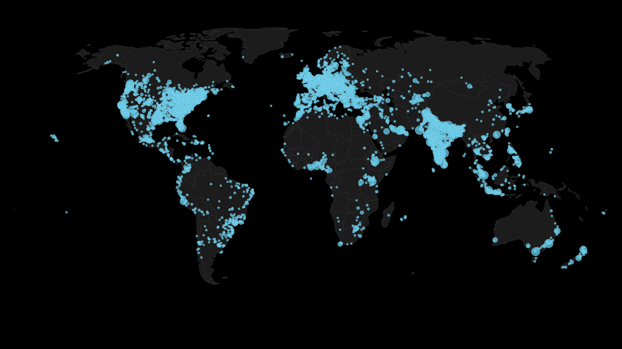
69,428 teens from around the world signed up for the Stardance Challenge.
Notes:
Dots are 0.5-degree grid cells of sign-ups, geocoded from IP at sign-up.

Slide 4
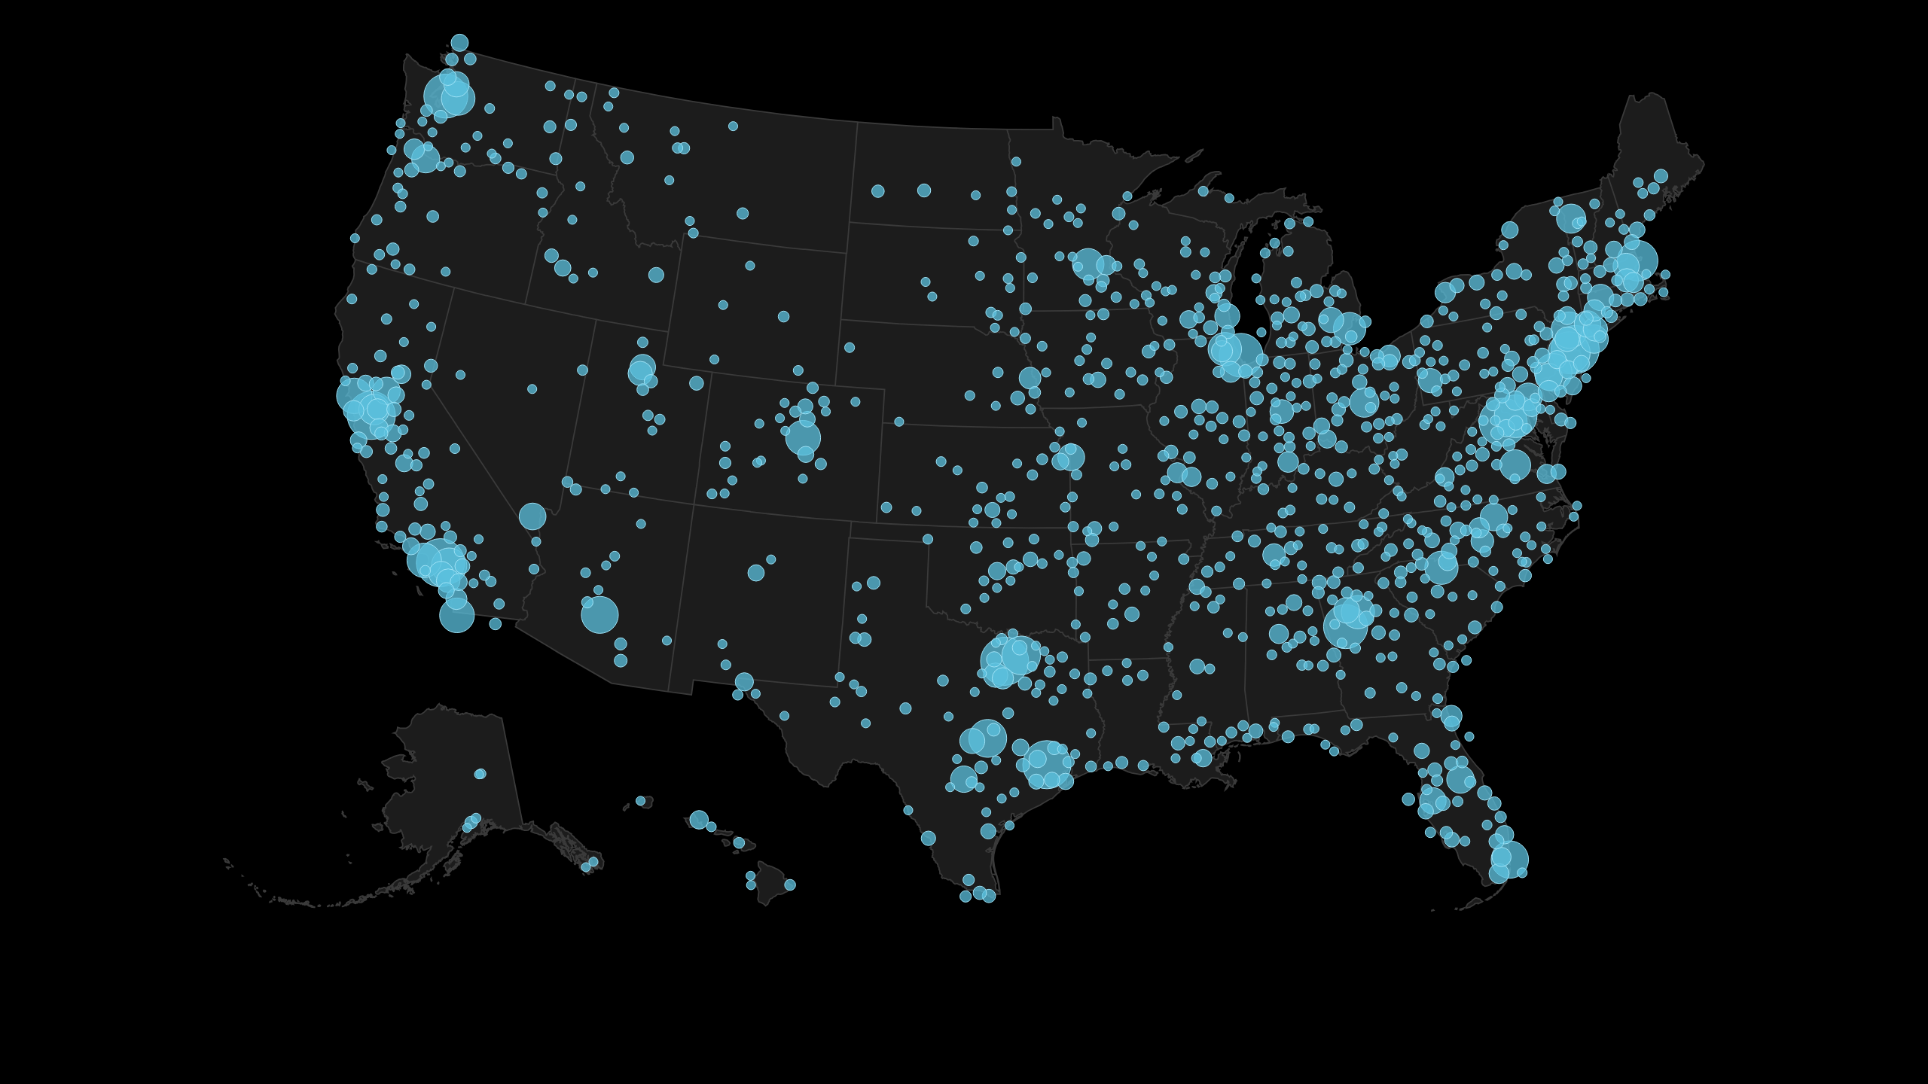
21,274 American teenagers from all 50 states + DC signed up.
Notes:
Top states by sign-ups: California, Texas, New York, New Jersey, Virginia.

Slide 5
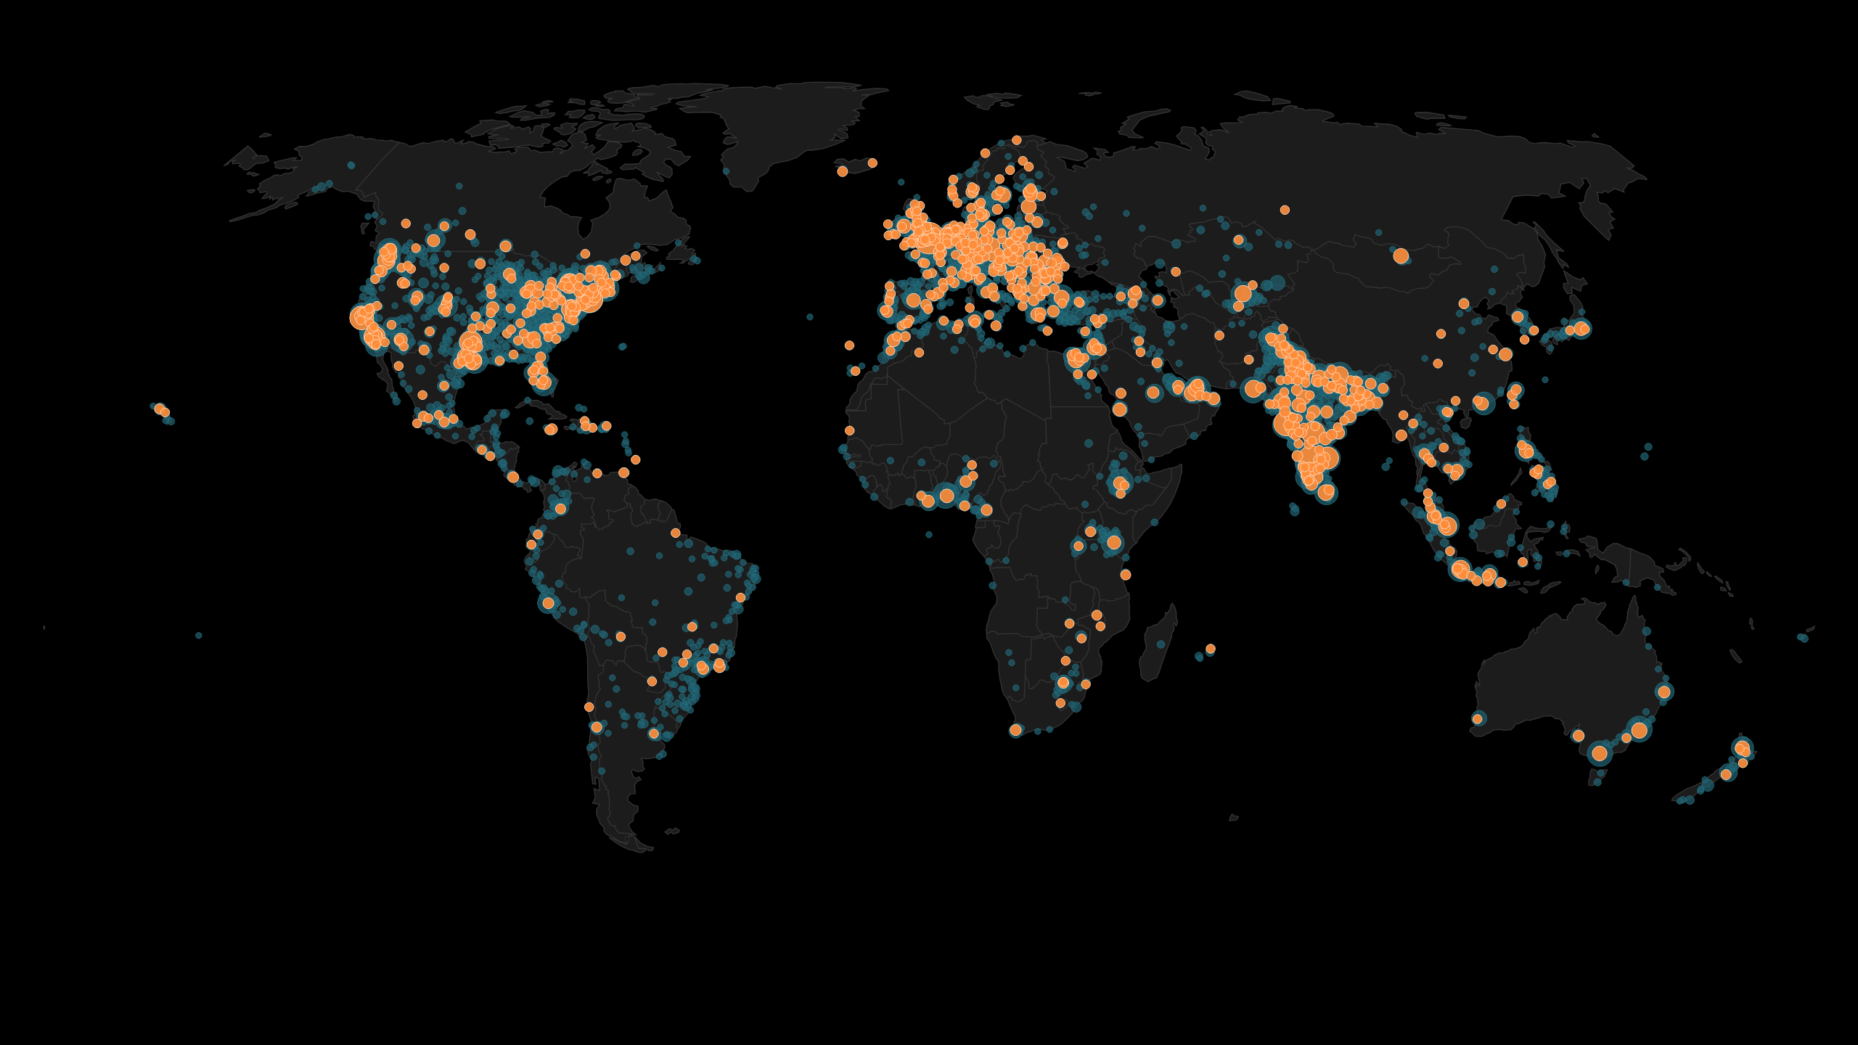
Orange: the 2,783 teens who came straight through AMD’s channels, from 116 countries and 49 US states.
Notes:
Orange dots are sign-ups attributed to AMD (the stardance.hackclub.com/amd links, teens who named AMD or the Linus Tech Tips video in the post-signup survey, plus a modeled share of unattributed sign-ups). Faint cyan dots are all sign-ups. 669 of the 2,783 are in the US.

Slide 6
77% of students who made engineering projects during Stardance had never shipped a real project before.
These students also spent 3× more time per week making projects during Stardance than in the three months before it
Hackatime (Hack Club’s open-source coding tracker) for the 8,012 teens who logged time on a Stardance project: most had no tracked activity before June 1. Their tracked coding went from about 3,900 hours/week (Mar–May) to about 11,100 hours/week (Jun–Sep).
Notes:
Method: public_hackatime_analytics.daily_activity joined to Stardance builders by email (same analysis as the NASA deck).

Slide 7
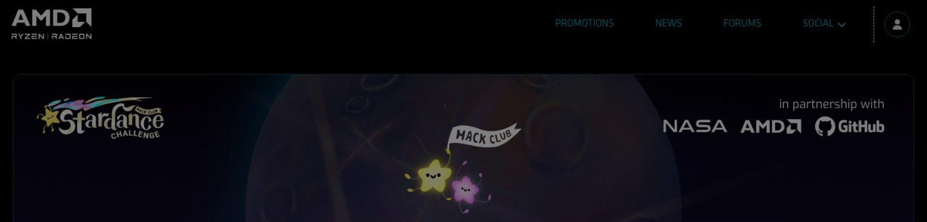
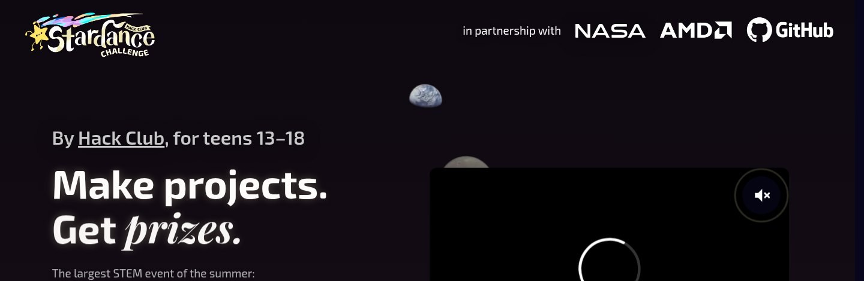
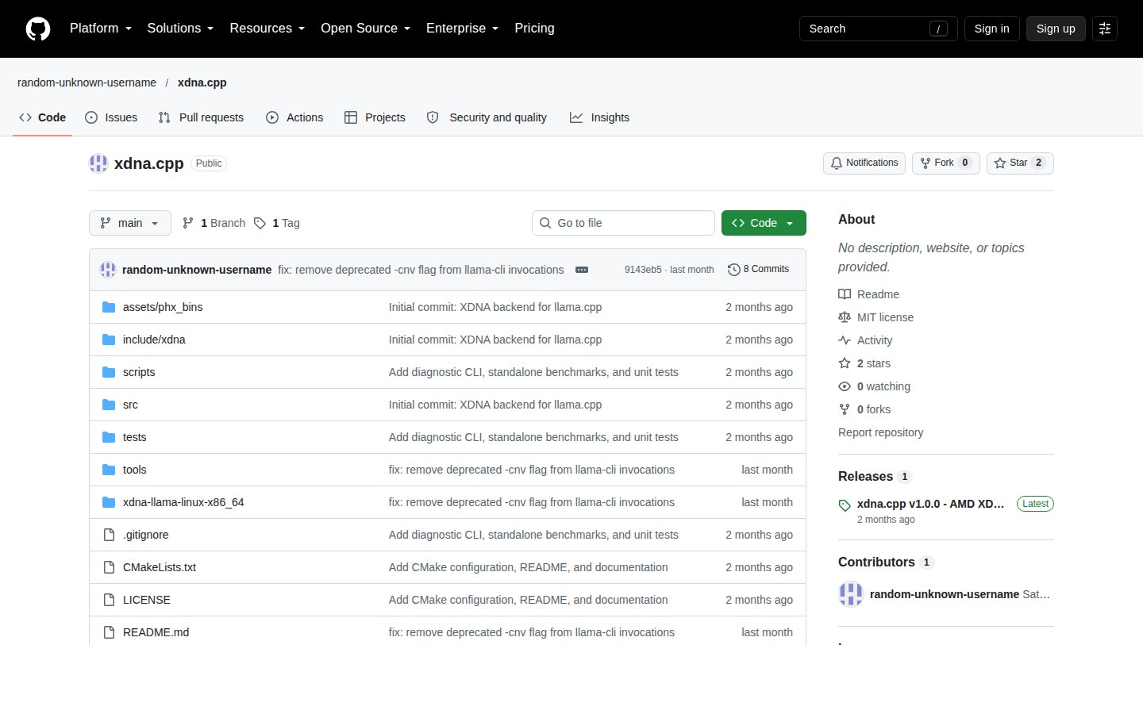
How AMD and Hack Club worked together to reach the next generation of builders
Launch day, June 1: AMD blog on amd.com, the amdgaming.com landing page, posts on AMD’s X, LinkedIn and Instagram, the Radeon Adrenalin driver banner (~1.8M downloads a month) and the AMD Gaming internal newsletter.
Email: external drops to AMD’s AI Dev Tools, Robotics, AI/ML, Game & Pro 3D Developer and Consumer/Gaming audiences (US + rest of world, June 2 and August), Big Connections to all AMD employees (June 3 and August), and a Stardance banner in every English-language AMD external email from June to August.
Linus Tech Tips video (June 5) with social cut-downs on AMD’s TikTok and Instagram; about 1,200 teens told us that video is how they found Stardance.
The AMD GPU raffle: 16 Radeon RX 9060 XT cards, one a week from June 5 to the close. 67,627 raffle participants, including 3,424 adults (19+) who referred teens; 6,322 sign-ups arrived through raffle referral links.
Hardware hackathon: AMD sponsored Outpost, Hack Club’s week-long hardware hackathon in San Mateo (July 14–20, 130 teens), whose projects were exhibited at Open Sauce.
Student stories: AMD’s AI marketing team reviewed the Ryzen AI NPU project; the LEGO 3D-printer post ran as an AMD × Hack Club collaboration; three vetted features are now with Hannah’s team.
Result: 2,783 teens signed up straight through AMD channels (669 American, 49 states, 116 countries) and 6,322 more through the AMD-powered raffle: together 13% of all sign-ups.
amdgaming.com: “AMD partners with Hack Club Stardance Challenge”
stardance.hackclub.com/amd, the landing page behind every AMD link
xdna.cpp: a 16-year-old’s llama.cpp backend for the Ryzen AI NPU, flagged to AMD’s AI marketing team in September
Notes:
Activation list from the June 1 launch email (Jackie Gillespie), the weekly Stardance Challenge Activation syncs and Jackie's June 5 note on the email banner. Attribution: /amd referral links + the post-signup 'how did you hear' survey + a modeled share of unattributed sign-ups (the method Zach and Deven agreed with Sasa in June; the dashboard AMD has seen all summer uses it). Linus Tech Tips: 1,322 users named LTT in the survey overall; about 1,200 of them are inside the AMD-attributed group. Raffle: raffle_weeks (16 x RX 9060 XT), raffle_participants, raffle_referrals (7,409 referrals, 3,903 verified).

Slide 8
Where the sign-ups came from, week by week
June 1 launch: AMD blog, driver banner, social; June 2 emails; June 5 LTT video. 11,548 sign-ups in week one, 1,032 of them via AMD or the raffle
Raffle week 2: 1,085 referral sign-ups in one week
May 11: posters land in US classrooms
August: second AMD external email + Big Connections
Sep 30: original close; extended to Oct 31
Pre-registration opened in April; the challenge ran June 1 – October 31 (originally September 30). Attribution: /amd links, post-signup survey and the raffle’s r- referral codes.
Notes:
Weekly first-seen sign-ups from materialized_all_signups. AMD channels peaked in launch week (599) and stayed at 100-300 a week through August while the email banner and LTT cut-downs ran; the raffle peaked in week two (1,085) when the GitHub email landed and teens started referring friends for GPU tickets.

Slide 9
What AMD set out to do, and what Stardance delivered
AMD’s goals for the partnership (from our kickoff meetings) | What the Stardance Challenge delivered
Reach 100,000 teens: five times Blueprint, which reached ~25,000 teens in three months | 69,428 sign-ups, the most of any Hack Club program ever (2.8× Blueprint). Blueprint’s three-month total was passed within two weeks of launch. 21,274 American teens from all 50 states + DC.
“Turn every AMD gamer into an AMD developer” | 26,632 sign-ups listed game development as an interest. 5,467 game projects started and 1,005 shipped; 493 Godot and 1,007 C++ repos among the shipped work.
Local AI on AMD hardware: Ryzen AI, Radeon, Instinct | 30,991 teens interested in AI/ML. 2,290 AI projects started (413 shipped), 165 built to run models locally. Student projects on the Ryzen AI NPU, Instinct CDNA4 and Kria.
A quality audience, not just impressions | AMD-referred teens went on to log tracked engineering hours at 14.7%, about 2× GitHub’s audience (7.6%) and 3× NASA’s (4.5%). 345 shipped projects and 8,922 tracked hours came from AMD-referred teens.
Stories AMD can tell: Newsroom, social, executive channels | Three vetted student features delivered for the November Newsroom story and carousel; the co-branded LEGO 3D-printer post (the student’s own video: ~500K views, 13K likes); 16 GPU raffle winners; the Sofia & Rosanna video.
Goals as stated in the March 9, March 31 and April 14 planning meetings. Interests are self-reported at onboarding; conversion is per sign-up source for teens who matched to an account.
Notes:
Blueprint: ~25,000 sign-ups Nov 2025-Jan 2026 (Sasa's June 8 email). Game/AI project counts are keyword matches on title + description of non-deleted projects; language counts are from GitHub repo language stats on shipped projects. Conversion: materialized_all_signups joined to users by email, then to non-deleted projects; 'logged hours' = any tracked time on a project.

Slide 10
AMD’s audience was the highest-converting partner audience in the challenge
14.7%
of AMD-referred teens logged tracked hours (401 of 2,736)
6.6%
shipped a project (181 teens, 345 projects) vs 3.7% for GitHub
8,922
tracked engineering hours by AMD-referred teens
2× / 3×
GitHub’s and NASA’s conversion rates, respectively
Notes:
Per-source conversion for sign-ups that matched a Stardance account (users table) by email. Groups: AMD = amd_referral_group; GPU raffle = gpu_raffle_referral_group; the rest are source_group. Hack Club's own email list (16.9%) and 'other/direct' (16.6%) are the only sources ahead of AMD.

Slide 11
Since AMD’s support began in November 2025, more than 86,000 teens have engaged with AMD-backed Hack Club programs
28,000 of them American; more than 4,100 shipped a finished project
Blueprint (Nov 2025 – Jan 2026, with the robot-arm hackathon and the CES stage moment) plus the Stardance Challenge (Jun – Oct 2026). Unique teens across both programs.
Notes:
This is the cumulative line Deven gave Christina for the board report on October 15 (Ruth Cotter sees it). Stardance alone: 69,428 sign-ups, 21,274 US, 3,718 teens shipped.

Slide 12
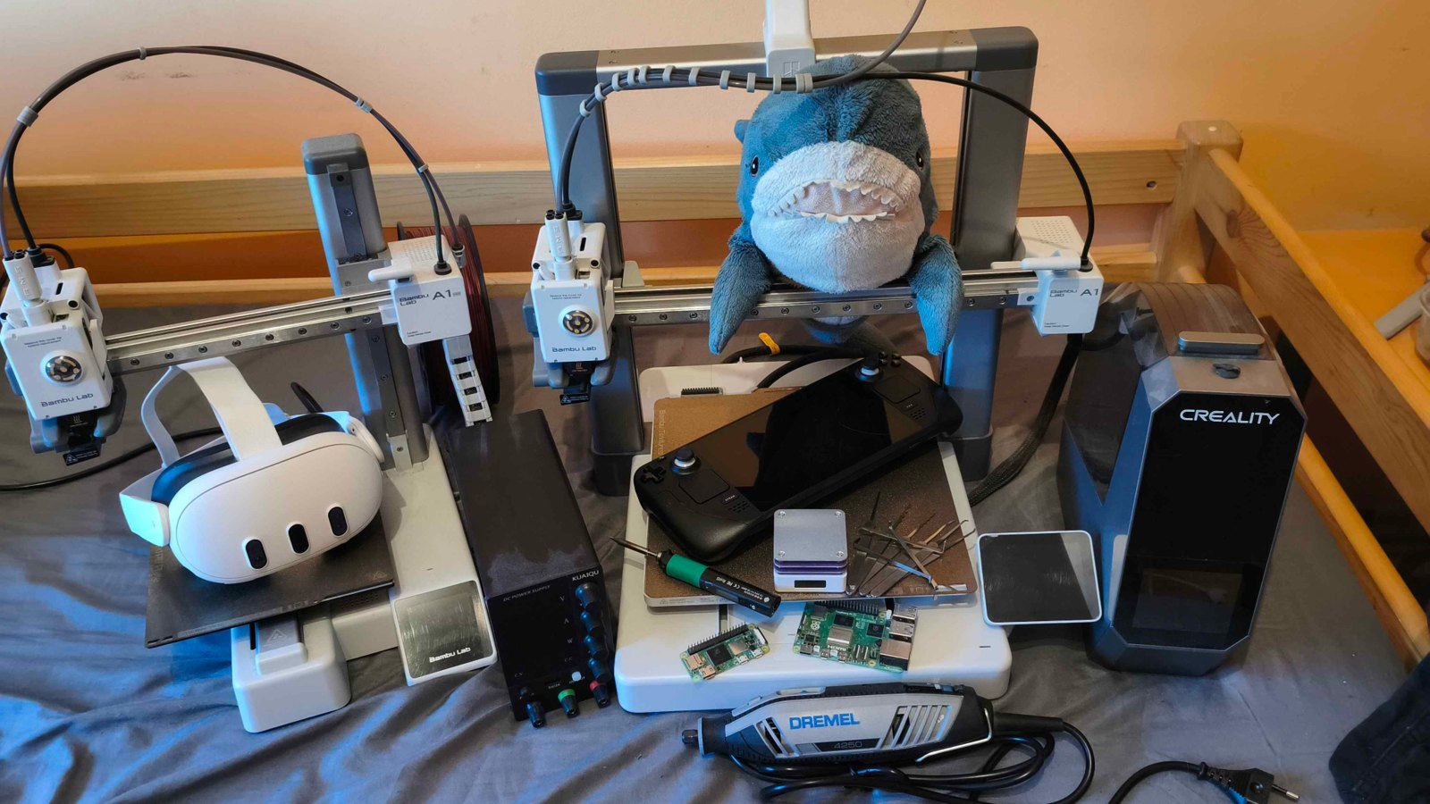
Project highlights: built on AMD silicon
xdna.cpp — a llama.cpp backend that runs quantized GGUF models on the Ryzen AI (XDNA1) NPU through the Linux amdxdna driver and XRT; the student reports a 3B model at 16.5 tok/s on the NPU vs 9.8 tok/s on the CPU. 87 hours. Age 16, India
GLM5.3 on AMD CDNA4 — persistent-kernel fusion for LLM inference on an Instinct MI-series GPU, worked out with no public reference material; 207 hours, renting the GPU out of pocket. Israel
Wintergreen — focused e-ink reading firmware written from scratch for an unsupported reader: partial refresh doubled battery life, plus a Bluetooth page-turner. Top 1% of peer ratings; a GPU raffle winner. Age 16, California
Face-Activated Servo — an edge-AI system on an AMD Kria KV260 with an Arduino, doing real-time face detection to steer a servo. 38 hours. California
LEGO 3D printer — a working printer built from LEGO and driven from a Ryzen 5 PC; it became the AMD × Hack Club collaboration post after the student’s own video drew ~500K views.
Tempname: Engine — a GPU rendering engine built for stylized control of shading; 165 hours and in the top 0.1% of peer ratings. Ohio
A Stardance builder’s desk: 3D printer, Raspberry Pi and VR headset, all earned by shipping projects
Notes:
INTERNAL, do not share: the xdna.cpp author was flagged by the fraud team on Sep 16 for inflated tracked time (coding agents; devlogs carried over from an earlier idea) and the Shipwrights flagged an AI-written README and rewritten git history. The code and repo are real and public and AMD (Sasa, Usman Pirzada, Hannah) already has the story, but verify before AMD amplifies the author by name. The GLM5.3/CDNA4 code is not yet public. Wintergreen = the e-ink reader Sasa discussed on Sep 10 (partial refresh technique). Peer ratings are the Stardance paired-comparison vote.

Slide 13
Games, engines and AI, from around the world
obliberry — a Fallout-inspired isometric game engine in C++20 and OpenGL with a visual editor and ECS; 440 hours. Sweden
BitDrop — a pachinko roguelike inspired by Slay the Spire and Balatro; 160 hours; top 1%. British Columbia
SpaceGuessr — GeoGuessr, but with real NASA imagery; 100 hours; top 1%. Germany
tinystudio — a 3D fantasy-console game engine where you can make anything; 110 hours. Massachusetts
Monado Phone Driver — an OpenXR fork that turns an Android phone into a PC VR headset; 77 hours; top 1%. Czechia
A game contained entirely within a Minecraft shader — 48 hours. Wisconsin
Noomo — a game where you predict the next word an LLM will generate. France · GVK renderer and City Sweep — a C++ Vulkan renderer and its tech demo. Hungary
Flower — a compiled, bootstrapped low-level programming language; 104 hours. Age 17, New Jersey
5,467 game projects started (1,005 shipped) · 2,290 AI projects (413 shipped) · among shipped repos: 493 Godot, 1,007 C++, 343 Rust, 280+ GLSL/HLSL shader projects.
Notes:
All from stardance.hackclub.com; hours are Hackatime-tracked; 'top 1%' is the peer-vote percentile. Not included on purpose: the Xbox x86-to-ARM translation layer (Ray asked to check emulation sensitivity with his Xbox contact first).

Slide 14
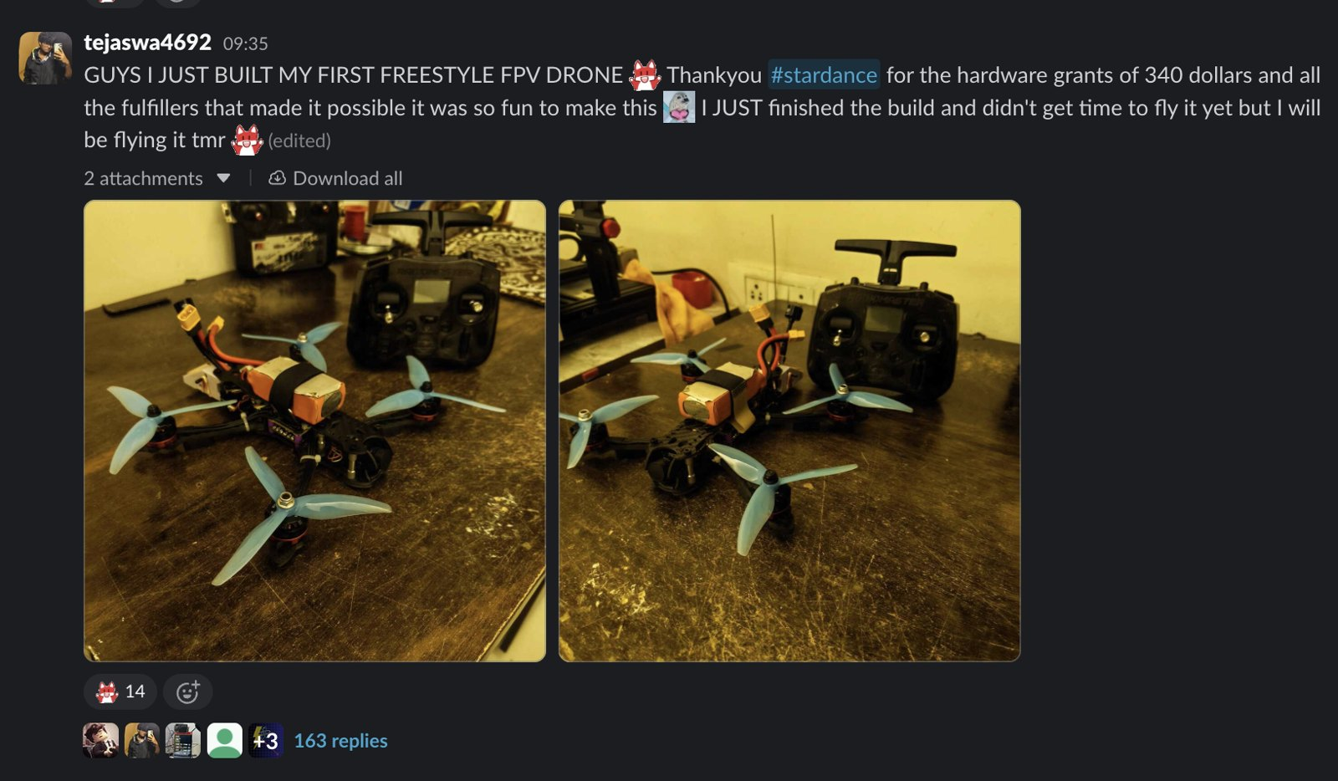
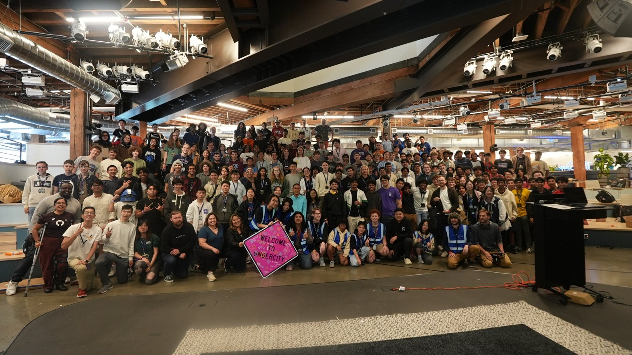
Turning teenagers’ bedrooms into makerspaces
15,573 hardware projects created since the start of Stardance.
1,425 hardware micro-grants worth $140,825 to 635 teens.
14,579 prize items delivered to 7,228 teens: 3D printers, Raspberry Pis, soldering irons, PCB and 3D-printing credits, keyboards, Framework laptops.
16 Radeon RX 9060 XT graphics cards, one a week, to raffle winners in the US and abroad; Hack Club covered international shipping.
652 certificates of completion, each after about 63 verified hours, recognized by AMD, MIT, GitHub and the Congressional App Challenge.
Outpost: 130 teens flown to a week-long hardware hackathon in San Mateo, CA (July 14–20) with a $20K AMD sponsorship; projects exhibited at Open Sauce (35,000 attendees).
Notes:
Hardware grants: approved certification_funding_requests. Prize items: fulfilled shop orders. Certificates: approved certificates, avg hours_at_issue 63. GPUs: raffle_weeks.

Slide 15
What’s next: the wrap-up, and the third AMD × Hack Club event
Wrap-up (Newsroom story Nov 2–3, student spotlights through December): final numbers on November 1, the morning after the challenge closes; photos and permissions for the carousel; students available for quotes; Ruth Cotter as the executive voice if useful.
Option 1 — Haven: Hack Club’s teen-organized weekend game jams, November 14–15, in about 250 cities worldwide (2,000 teen organizers). AMD as presenting partner: co-branding, AMD employees as mentors in office cities, Radeon and Ryzen prizes, a “best game” track judged by AMD.
Option 2 — a five-day Thanksgiving / Black Friday online hackathon: a tight brief (local AI on AMD hardware, or agents), a daily GPU raffle, three to five winners with hardware prizes.
Hooks on AMD’s calendar: The Game Awards (Dec 10) spot and tickets as prizes; AMD Developer Program access tied to an open-source AI track; a CES moment with students on stage, as in January.
2027: a multi-year plan for Stardance 2 (Q1 2027) and the next in-person events; Christina and Zach will follow up with a proposal.
Ask for today: which option AMD prefers for the third event, and who at AMD owns the wrap-up assets.
Notes:
Sasa asked on Sep 10 for two one-paragraph options to review internally. Haven: Airtable 'YSWS - Haven', all events start 2026-11-14. The Advancing AI hackathon was cancelled on June 29 (no stage moment, budget); AMD kept the $20K Outpost sponsorship.

Slide 16
Thank you for helping change the lives of teenagers across the world!
Hack Club · hackclub.com · stardance.hackclub.com/amd
Contact: Deven Jadhav (deven@hackclub.com), Chief of Staff, Programs · Zach Latta (zach@hackclub.com) · Christina Asquith (christina@hackclub.com)

Slide 17
We asked teenagers how they found Stardance and what they built. Here’s what they said:
“I found out about it from Linus Tech Tips (under the AMD account) on TikTok.” – how one teen heard about Stardance
“The AMD channel on TikTok, with Linus Tech Tips explaining it.” – another
“My friend invited me (he wanted tickets in the GPU raffle, haha).” – another
“My dad works for AMD, so he got an email about it, and I was already thinking about working on a project…” – the child of an AMD employee
“My laptop already had an AI accelerator built into the processor, but almost every local LLM tool I used focused on CPUs or GPUs and basically ignored the NPU, so I wanted to figure out how the hardware actually worked and see whether I could make normal llama.cpp models use it.” – age 16, India, on building xdna.cpp
NPS 63 across 5,883 feedback responses (69% promoters, 6% detractors).
Notes:
Verbatim from the Stardance feedback surveys (Fillout) and the student's own project write-up for AMD, lightly edited for spelling.

